Slide 1
Describing an enlargement
Transformations

Slide 2
how to use Oak lessons

Slide 3
I can understand the minimum information required to describe an enlargement.

Slide 4
Scale factor is the multiplier between similar shapes that describes how large one shape is compared to the other.
The centre of enlargement is the point from which a shape is enlarged.

Slide 5

Describing and enlargement
Using and finding scale factors
How the centre of enlargement affects the image

Slide 6
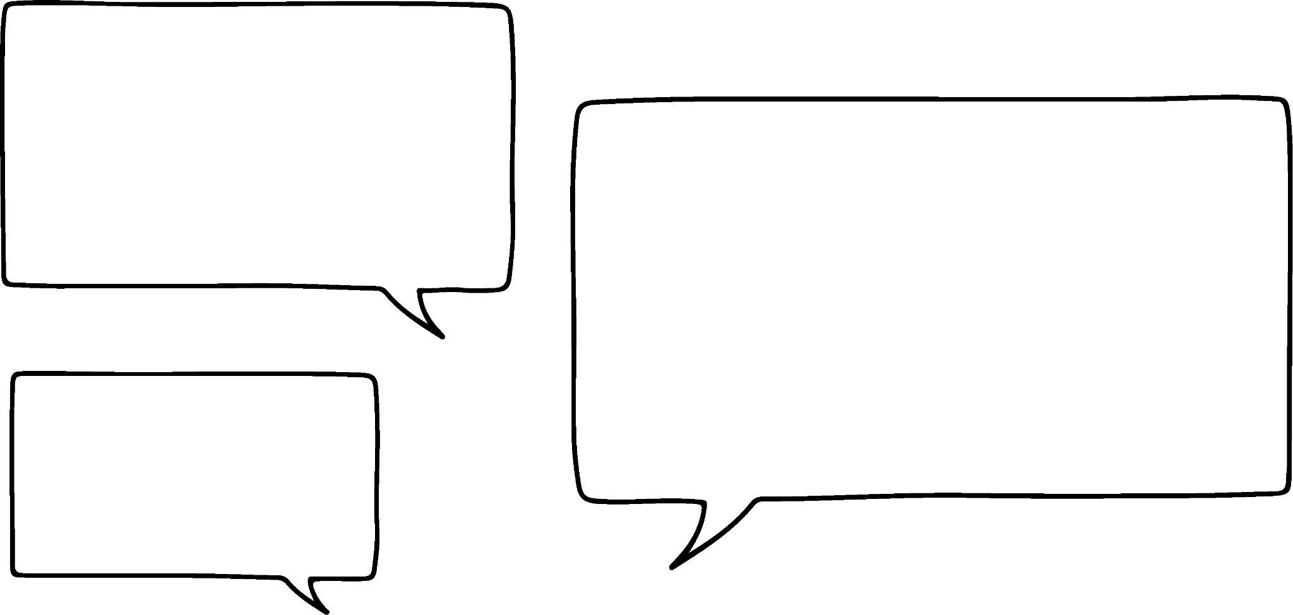

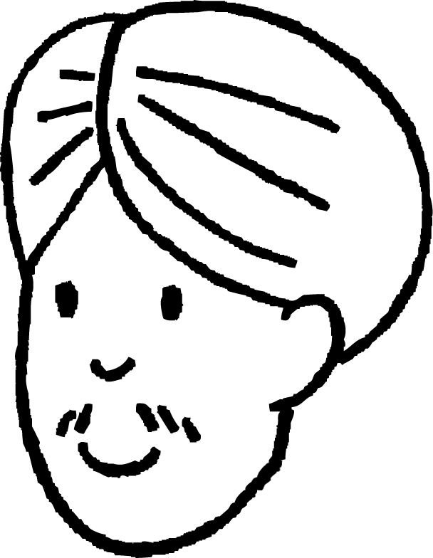
Using and finding scale factors
The object has been enlarged to create the image.
2 cm
5 cm
6 cm
object
image
15 cm
How could we describe the change in size?
It has got 4 cm longer in one direction and 10 cm longer in the other.
The lengths of the image are 3 times the lengths of the object.
Laura
Andeep

Slide 7
Using and finding scale factors
A scale factor is a multiplier between similar shapes that describes how large one shape is compared to the other.
× 3
2 cm
5 cm
6 cm
object
image
× 3
15 cm
An enlargement can be described by stating the scale factor from the object to the image.

Slide 8


Using and finding scale factors
The scale factor can be calculated by dividing a length from the image by its corresponding length in the object.
The scale factor is the same for all pairs of corresponding lengths.
2 cm
5 cm
6 cm
object
image
15 cm
scale factor = 3

Slide 9


Using and finding scale factors
The scale factor can be calculated by dividing a length from the image by its corresponding length in the object.
The scale factor can also be a fraction.
2 cm
5 cm
6 cm
image
object
15 cm
scale factor =

Slide 10

Using and finding scale factors
Calculate the scale factor for the enlargement.
5 units
20 units
object
image
scale factor

Slide 11

Using and finding scale factors
Calculate the scale factor for the enlargement.
8 units
4 units
object
image
scale factor

Slide 12


Using and finding scale factors
The scale factor for an enlargement can be used to calculate missing lengths in the image.
× 4
6 cm
image
object
2 cm
× 4
scale factor
8 cm
missing length

Slide 13
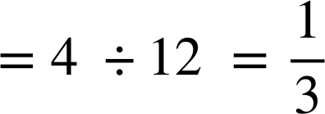
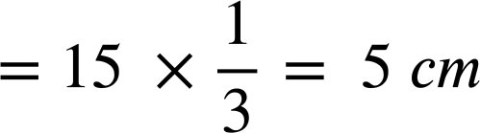
Using and finding scale factors
The scale factor for an enlargement can be used to calculate missing lengths in the image.
3 cm
4 cm
12 cm
image
object
scale factor
15 cm
missing length

Slide 14

Using and finding scale factors
The object has been enlarged to create the image. What is the value of ?
object
image
4
16
5 cm
4 cm
20 cm
20
25
cm

Slide 15
Using and finding scale factors
The object has been enlarged to create the image. What is the value of ?
5
30 mm
mm
10 mm
10
image
20
60 mm
object
90

Slide 16
Using and finding scale factors
1. Parallelogram P has been enlarged to create A, B, C and D. Calculate the missing lengths on each parallelogram.
8 cm
B
3 cm
C
2 cm
9 cm
P
6 cm
_
_
20 cm
18 cm
D
A
_
_

Slide 17
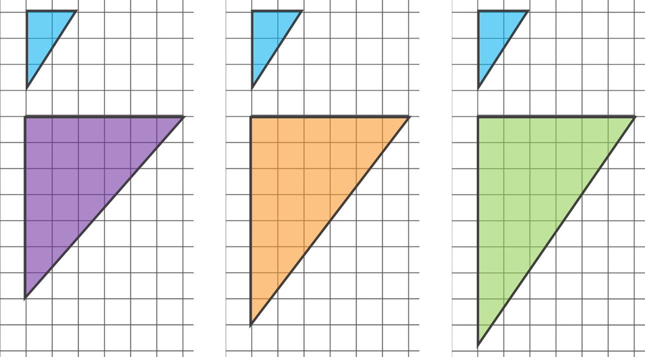
Using and finding scale factors
2. Tick the diagram that shows a correct enlargement of the small triangle.
Sam draws another enlargement of the small triangle. One of the lengths is 12 cm. What could the other length be?

Slide 18
Using and finding scale factors
1. Parallelogram P has been enlarged to create A, B, C and D. Calculate the missing lengths on each parallelogram.
8 cm
B
3 cm
C
2 cm
9 cm
P
6 cm
4 cm
3 cm
20 cm
18 cm
D
A
16 cm
15 cm

Slide 19
Using and finding scale factors
2. Tick the diagram that shows a correct enlargement of the small triangle.
Sam draws another enlargement of the small triangle. One of the lengths is 12 cm. What could the other length be?
8 cm or 18 cm
Or if the diagonal length is measured as 12 cm then the other two lengths would measure as approximately 6.7 cm and 10 cm.

Slide 20
Describing and enlargement
Using and finding scale factors
How the centre of enlargement affects the image

Slide 21
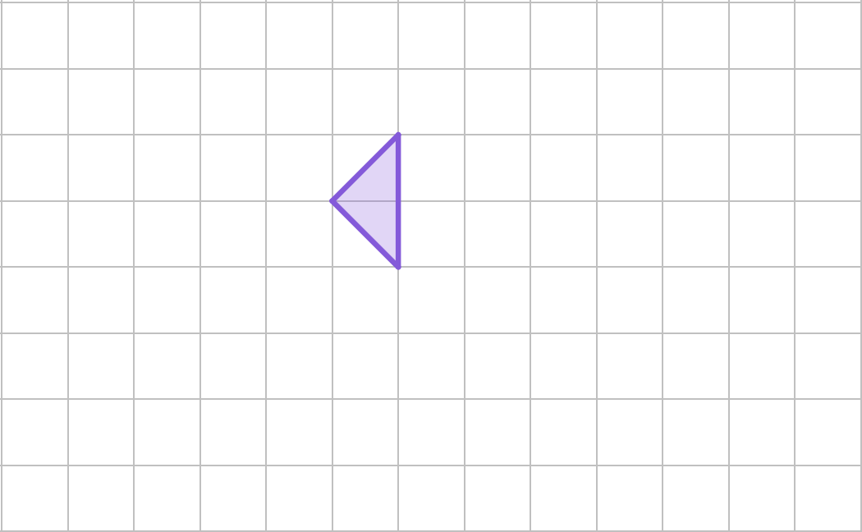

How the centre of enlargement affects the image
Aisha is going to enlarge the object by a scale factor of 2, but she is not sure where to place the image on the grid.
object

Slide 22
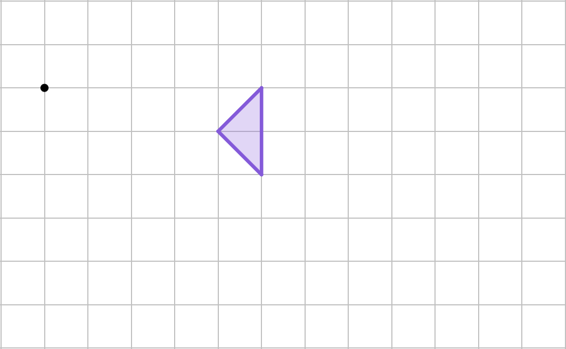
How the centre of enlargement affects the image
The centre of enlargement is a point from which an object is enlarged.
centre of enlargement
object

Slide 23
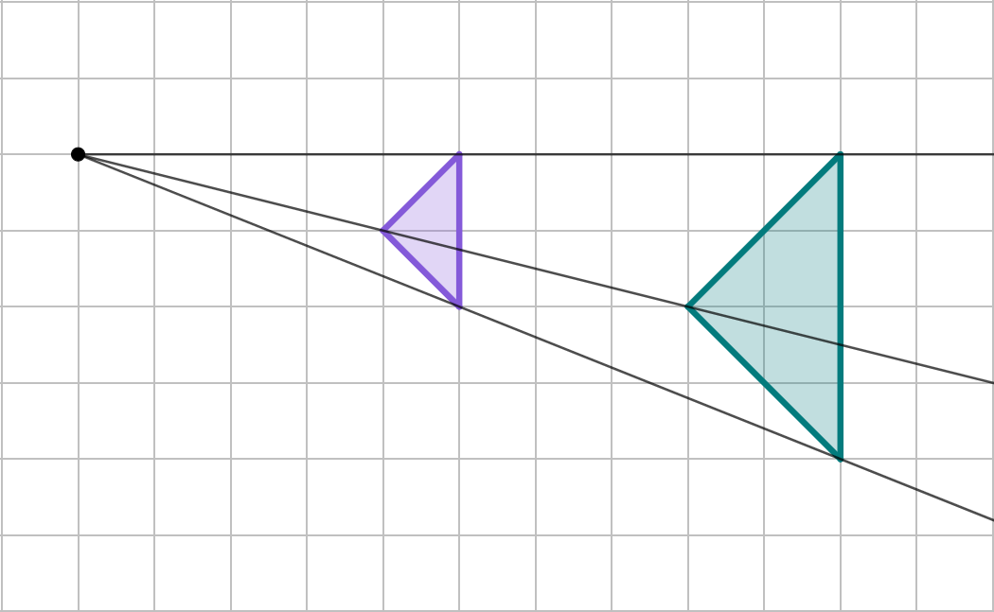
How the centre of enlargement affects the image
The scale factor not only affects the lengths in the image but also how far each vertex is away from the centre of enlargement.
centre of enlargement
10 units
scale factor = 2
5 units
object
image

Slide 24
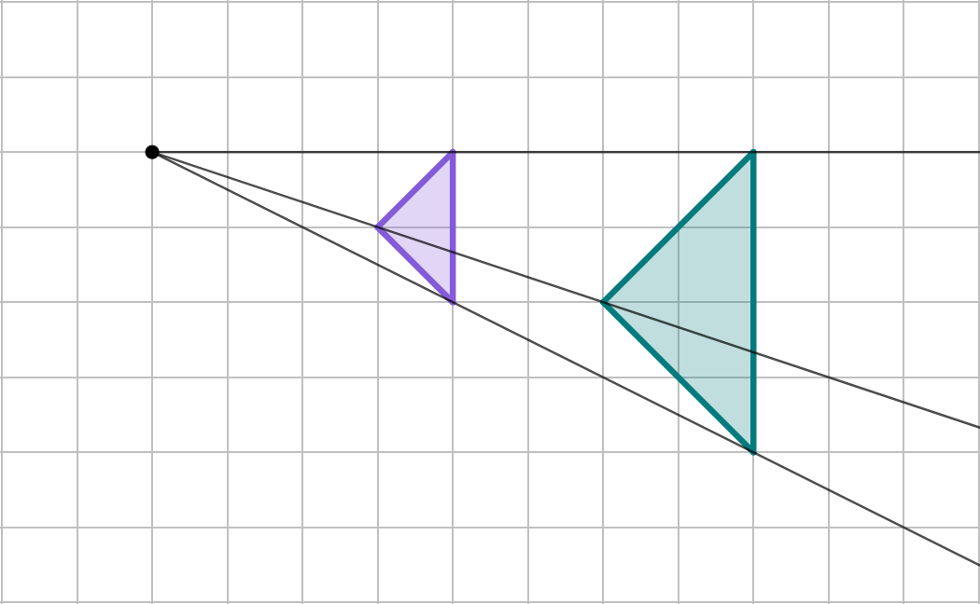
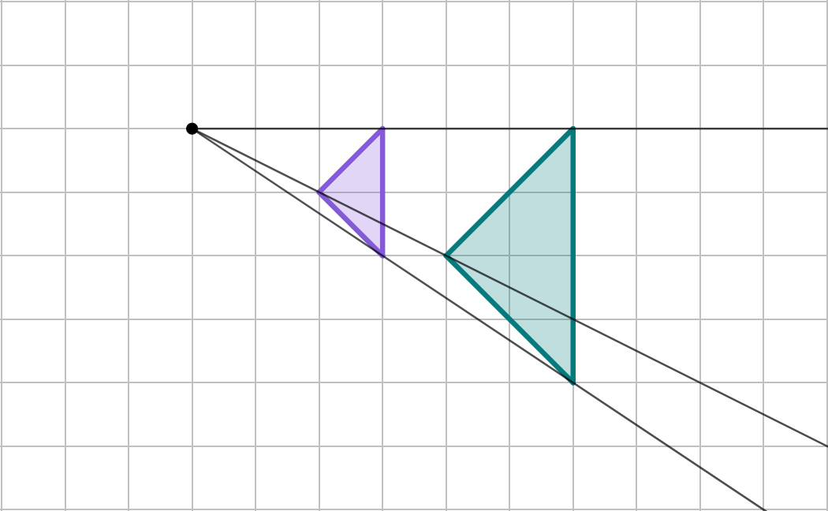
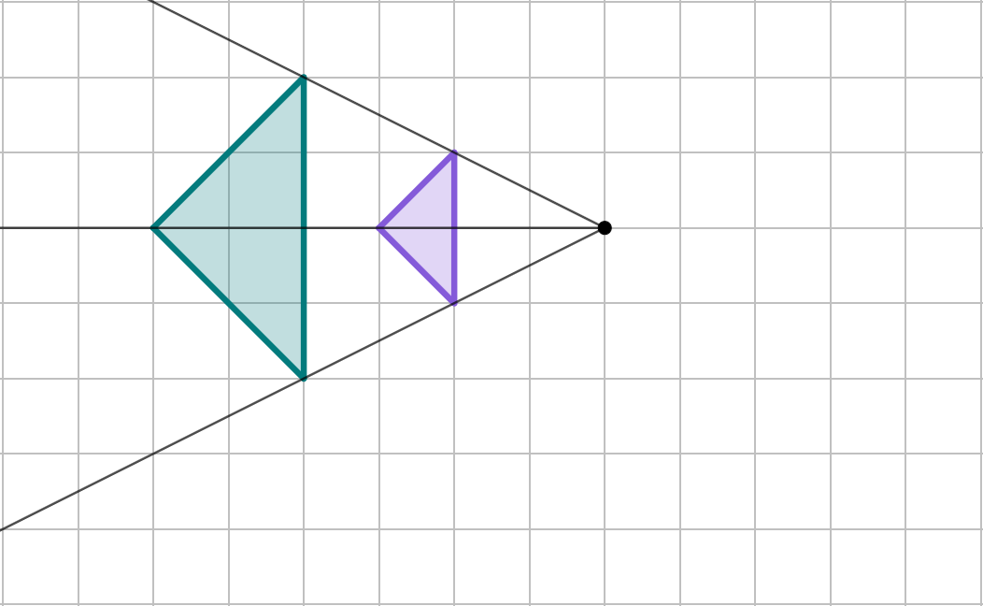
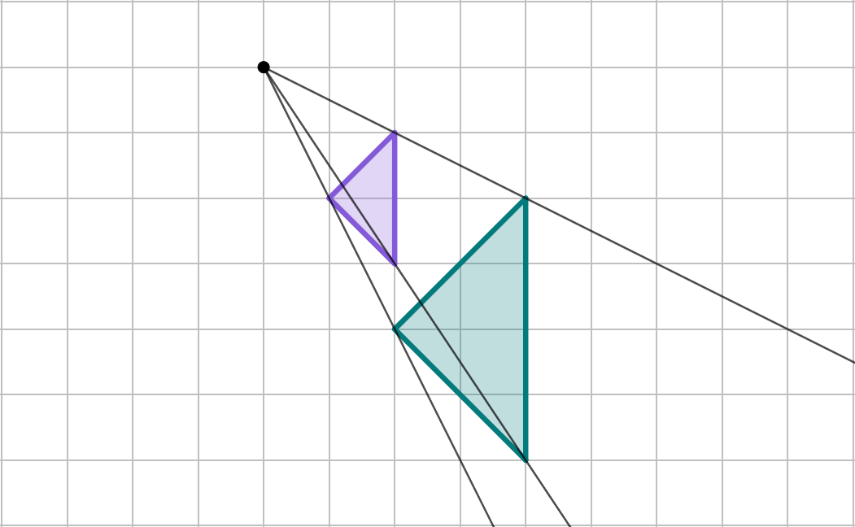
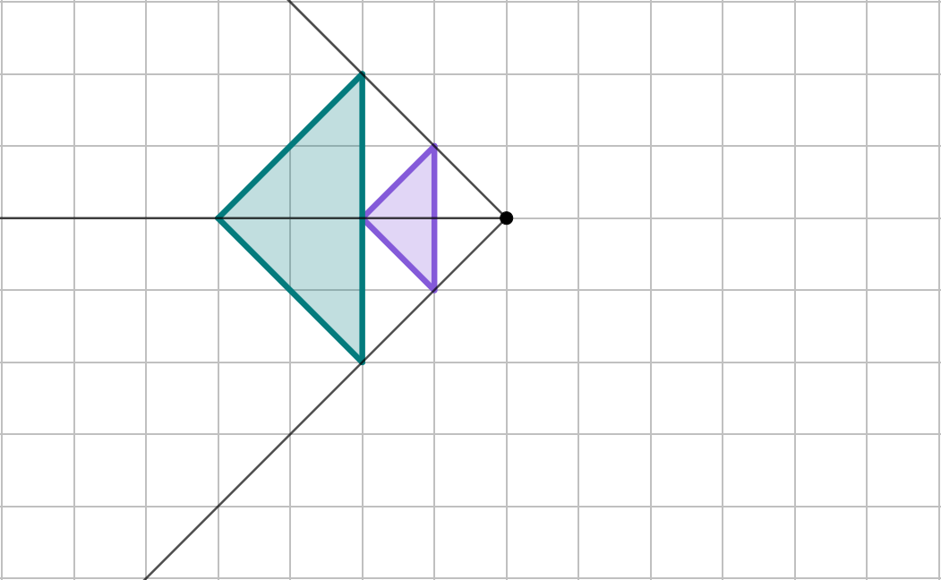
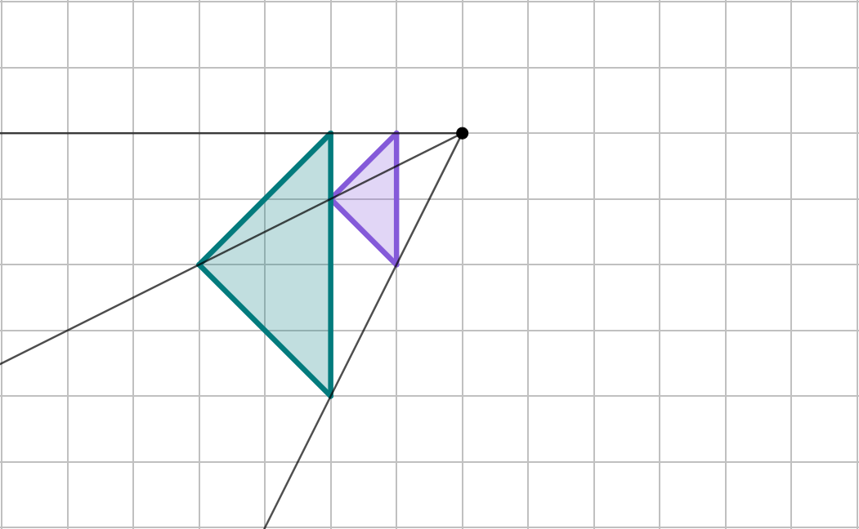
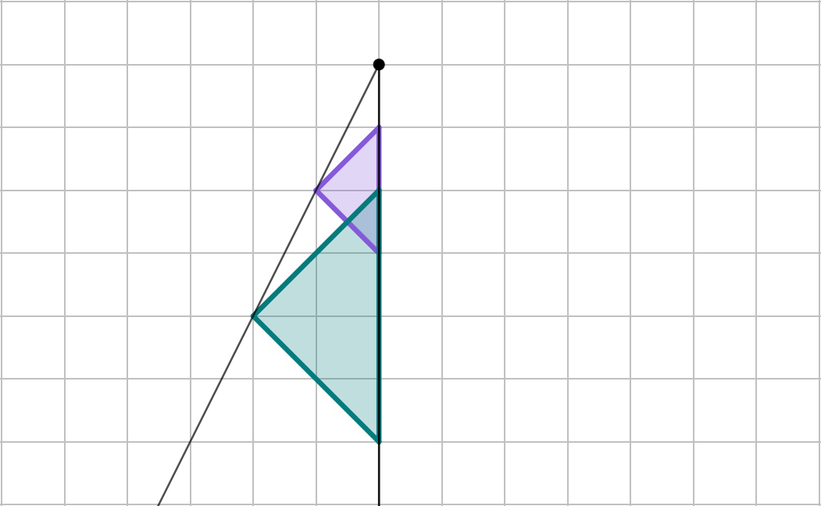
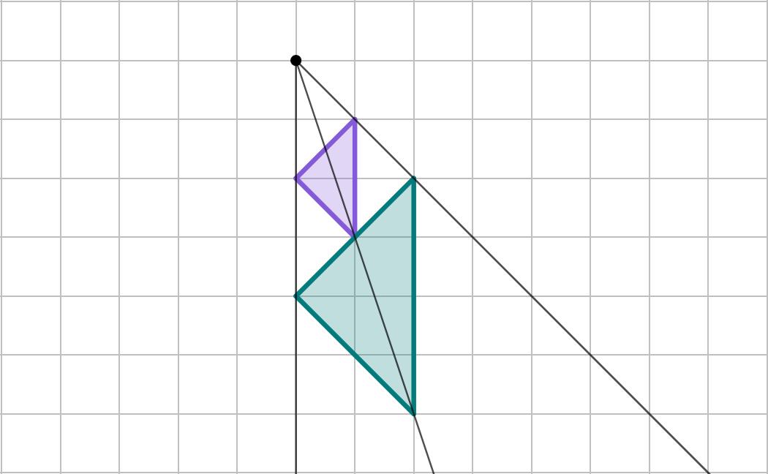
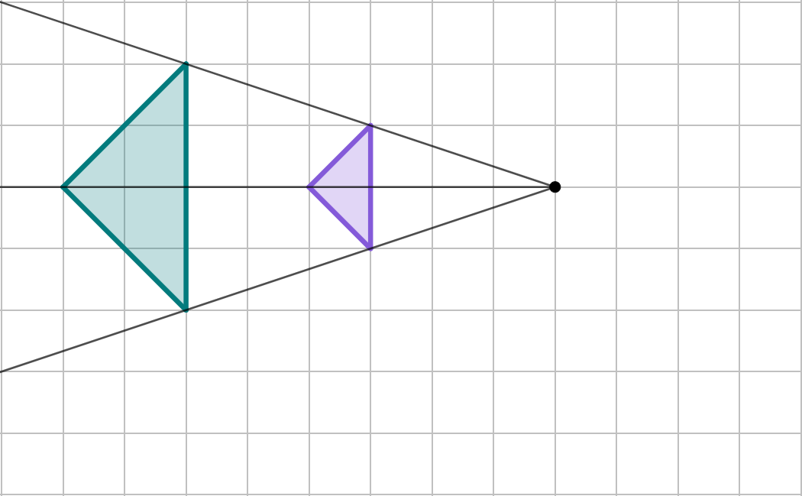
How the centre of enlargement affects the image
The position of the centre of enlargement defines where the image will be placed in relation to the object.

Slide 25
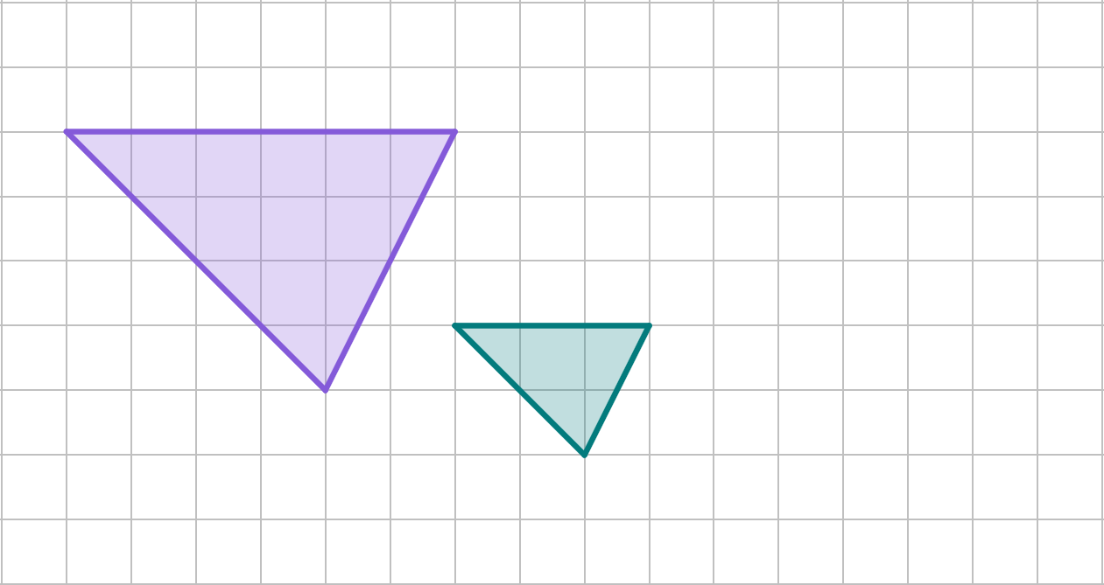
How the centre of enlargement affects the image
The centre of enlargement can be found by drawing lines through corresponding vertices of the object and image.
centre of enlargement
The point where the lines intersect is the centre of enlargement.

Slide 26
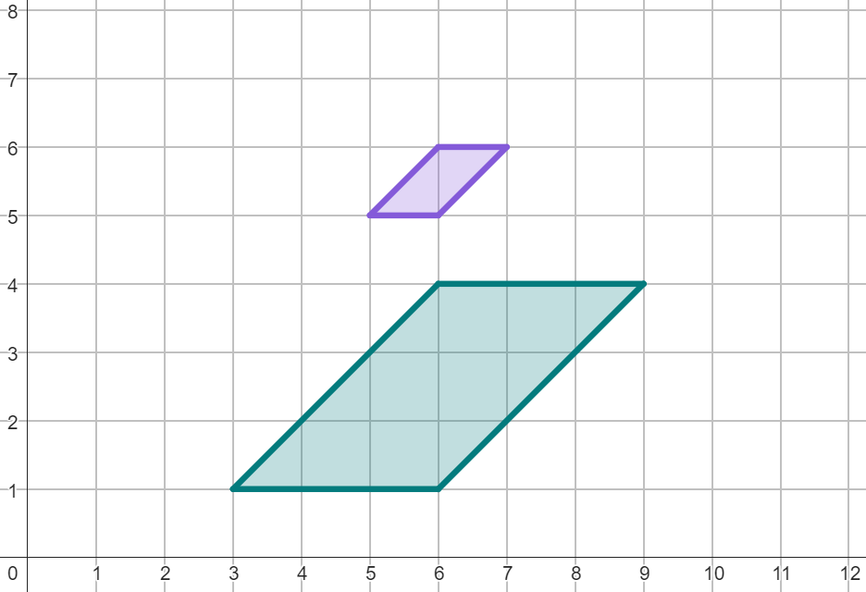
How the centre of enlargement affects the image
Find the coordinates of the centre of enlargement.
centre of enlargement at (6, 7)

Slide 27
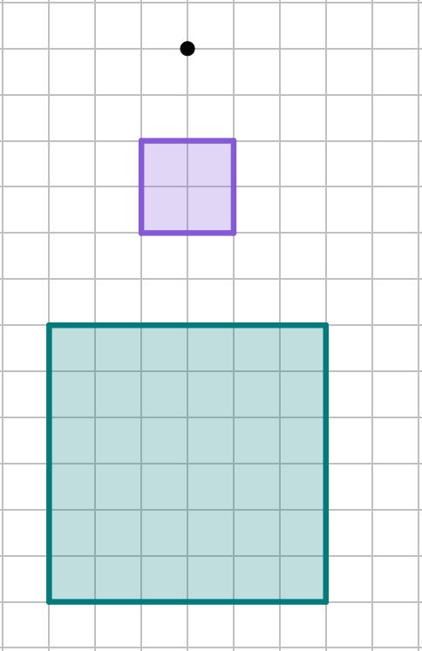
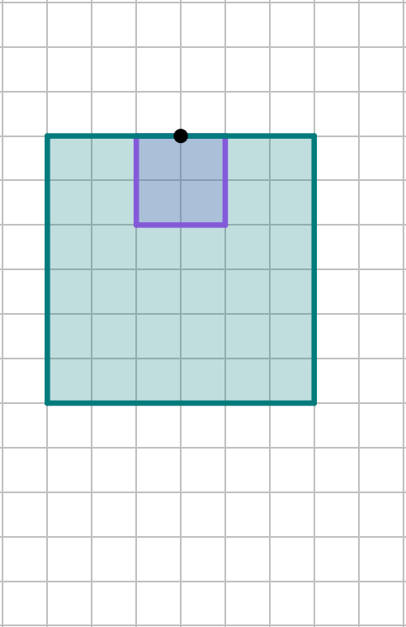
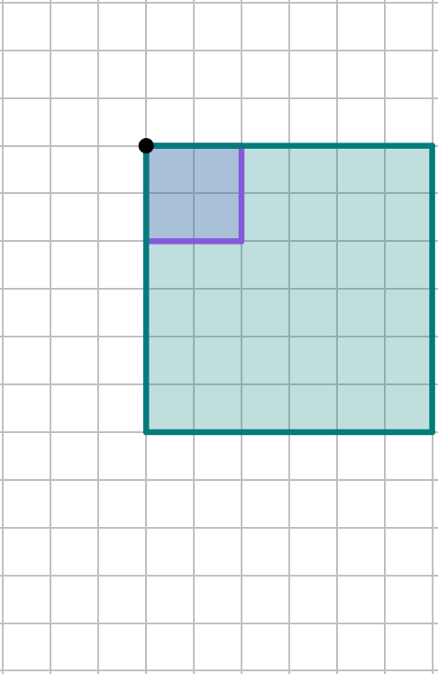
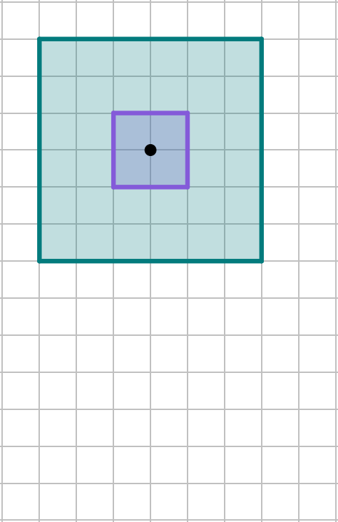
How the centre of enlargement affects the image
The centre of enlargement can be anywhere on or off the object.
That point will remain invariant in the image.
outside
on an edge
on a vertex
inside

Slide 28
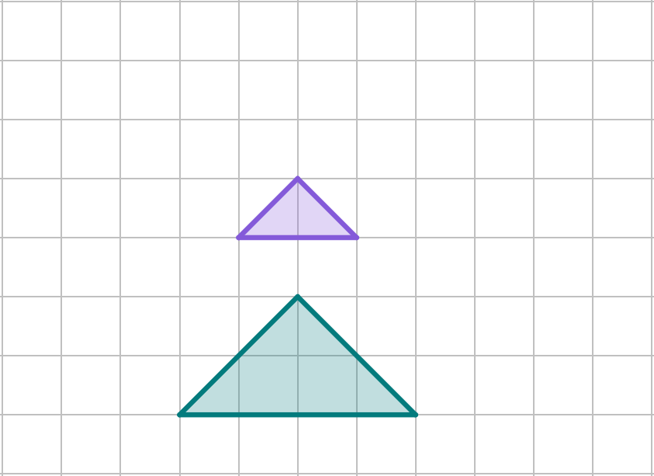
How the centre of enlargement affects the image
Which diagram has a correctly drawn a line to locate the centre of enlargement?

Slide 29
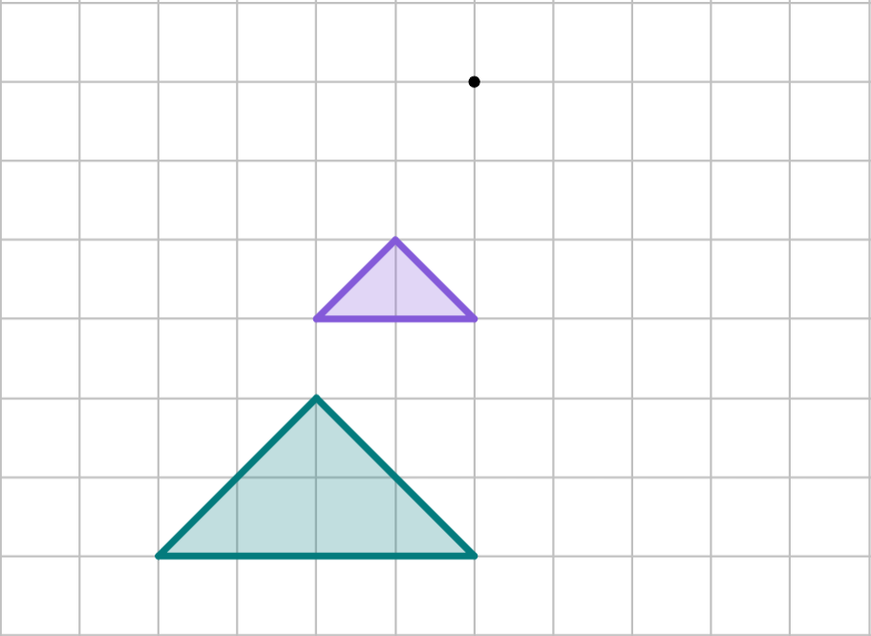
How the centre of enlargement affects the image
If the centre of enlargement moved to the right, in which direction would the image move?
centre of enlargement
left
right
object
up
down
image

Slide 30
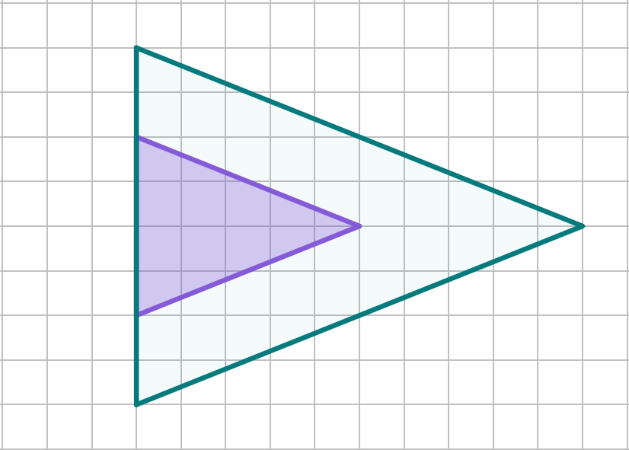
How the centre of enlargement affects the image
At which point is the centre of enlargement?
A
A
B
B
C
D
C
D

Slide 31
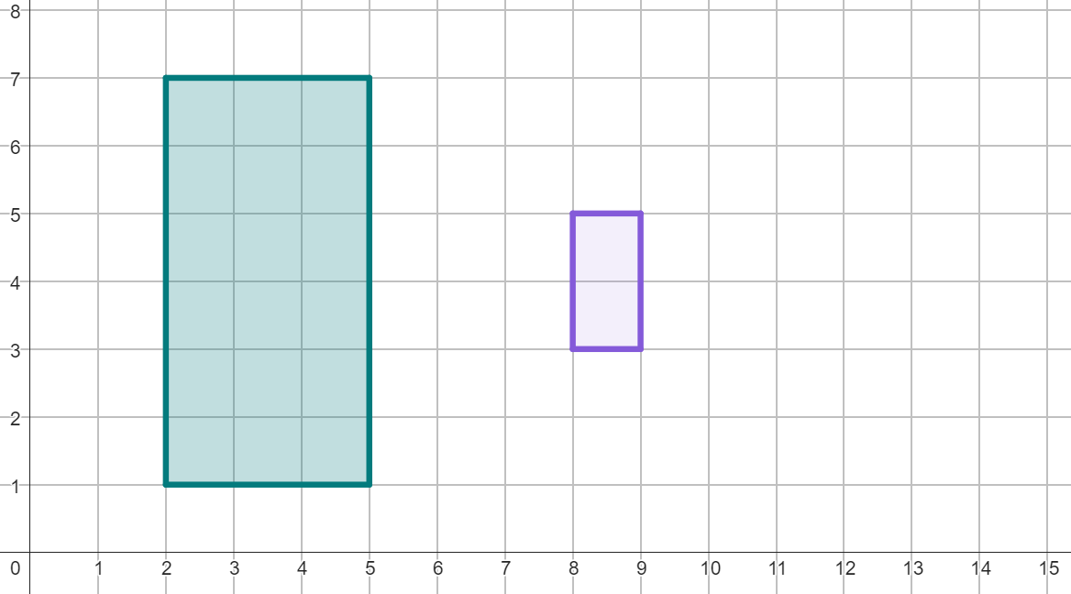

How the centre of enlargement affects the image
A full description of an enlargement requires both the scale factor and the centre of enlargement.
Example: fully describe the transformation from A to A′.
scale factor
A′
A
centre of enlargement at (11, 4)
(11, 4)
1 unit
Object A has been enlarged by a scale factor of 3 from the point (11, 4).
3 units

Slide 32
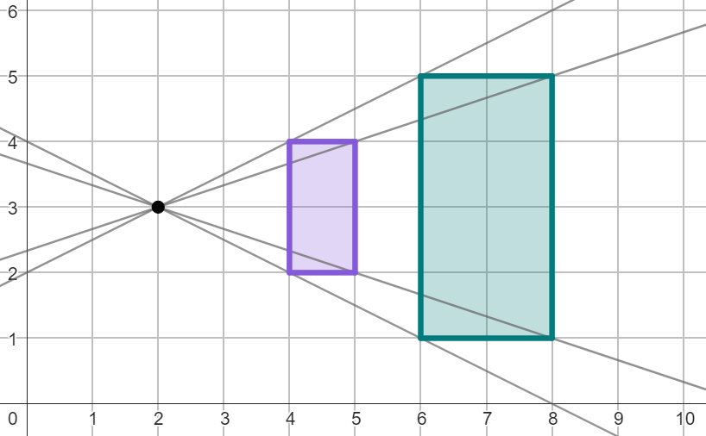
How the centre of enlargement affects the image
Which information is missing from this description below?
Object A has been enlarged by a scale factor of 2.
centre of enlargement
line of symmetry
scale factor
A
A′
vector

Slide 33
How the centre of enlargement affects the image
Which information is missing from this description below?
Object A has been enlarged from the point (2, 3).
centre of enlargement
line of symmetry
scale factor
A
A′
vector

Slide 34
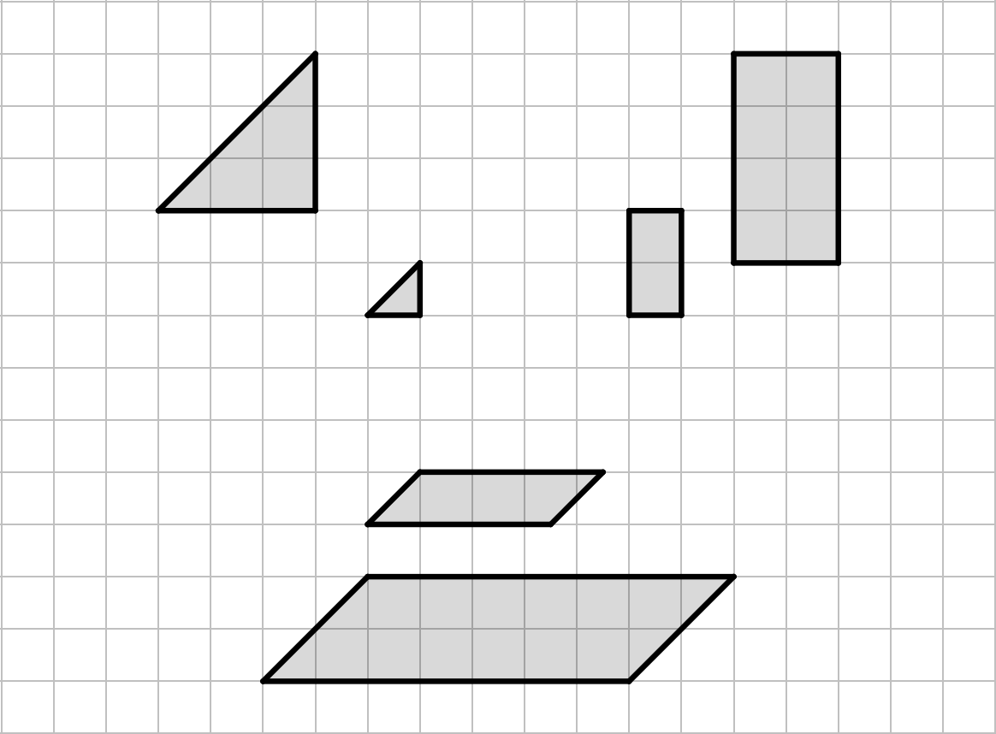
How the centre of enlargement affects the image
1. Tick the enlargements that have the same centre of enlargement.
A to A′
B to B′
C to C′
A′
B′
A
B
C′
C

Slide 35
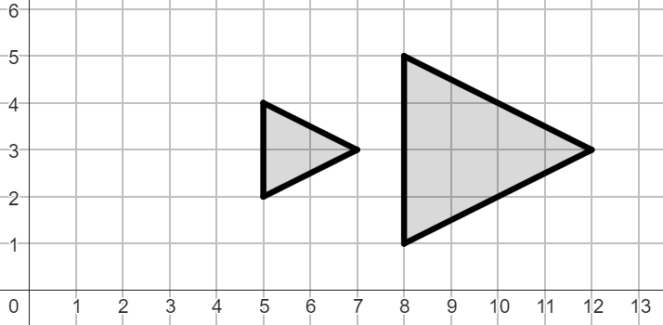
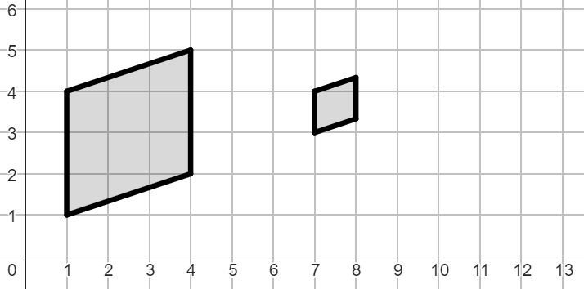
How the centre of enlargement affects the image
2. Describe each transformation fully.
a) A to A′
b) B to B′
B′
A
A′
B

Slide 36
How the centre of enlargement affects the image
1. Tick the enlargements that have the same centre of enlargement.
A to A′
B to B′
C to C′
A′
B′
A
B
C′
C

Slide 37

How the centre of enlargement affects the image
2. Describe each transformation fully.
a) A to A′
b) B to B′
B′
A
A′
B
Object A has been enlarged
by a scale factor of ,
from the point .
Object B has been enlarged
by a scale factor of ,
from the point .
2
(2, 3)
(10, 4)

Slide 38
Describing an enlargement
During an enlargement, the scale factor is the multiplier that describes how large the image is compared to the object.
The centre of enlargement defines where the image will be placed in relation to the object.
The centre of enlargement can be found by drawing lines through corresponding vertices of the object and image to find where they intersect.
Describing an enlargement fully requires both the scale factor and the centre of enlargement.
The object and the enlarged image have the same orientation for positive scale factors.

Slide 39

© Oak National Academy 2023.
Produced in partnership with Mathematics in Education and Industry.
Licensed on the Open Government Licence v3.0, except where otherwise stated. See Oak terms and conditions.

